Slide 1


Slide 2
Session 1
The aim of this session is to support you in organising your time to revise and to help you identify what resources you will need to successfully prepare for the summer examinations.

Slide 3
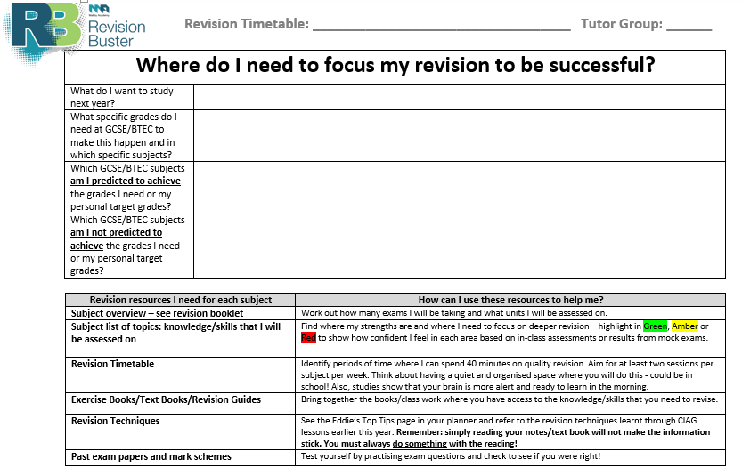
Use the other side of your revision timetable to set your goals and identify where your focus should be.
There is also a useful list of resources you will need to have access to in order to successfully prepare for your examinations with strategies to adopt in order to use them effectively.
Aim to revise for at least two sessions per week on these subjects
Aim to revise for at least three sessions per week on these subjects

Slide 4
Use the other side of your revision timetable to set your goals and identify where your focus should be.
There is also a useful list of resources you will need to have access to in order to successfully prepare for your examinations with strategies to adopt in order to use them effectively.

Slide 5
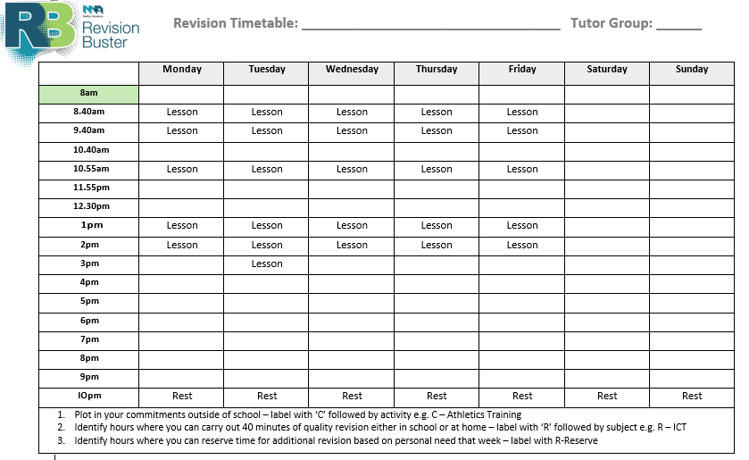
Complete the table:
Plot in your commitments outside of school – label with ‘C’ followed by activity e.g. C – Athletics Training
Identify hours where you can carry out 40 minutes of quality revision either in school or at home – label with ‘R’ followed by subject e.g. R – ICT
Identify hours where you can reserve time for additional revision based on personal need that week – label with R-Reserve

Slide 6
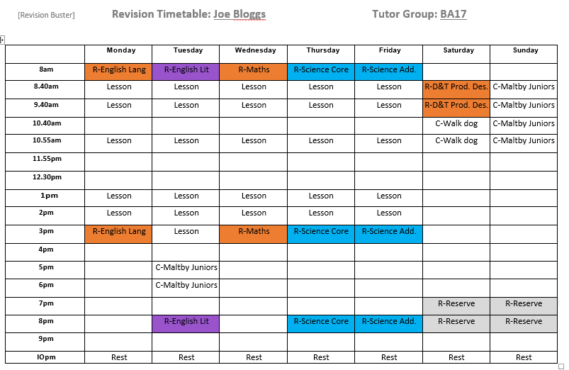
See example:
This example has also used a colour system to highlight (based on learning cycle):
Subjects where I may be underperforming in Blue
Subjects where I may be on track to achieve target in Amber
Subjects where I may be predicted to achieve above target in Purple

Slide 7
Tips for revision:
Gather all the resources you need to revise – organise them by subject
Utilise your revision timetable – balanced across all subjects
Stick to your timetable/revision plan but amend if necessary
Stick to your commitments such as clubs that you might attend and revise around these
Mornings are optimal times for revising – try to avoid revising too late
Make use of time/space immediately after school for revision
35-40 minutes is optimal time for revision
Find a space to revise that is quiet/free of distractions
Remember: simply reading text will not make the information stick – always do something with the reading see Revision Buster 2!
Stay hydrated – drink plenty of water
Have 15 minute breaks between revision sessions as a reward – do something in this time that excites you: kick a football, play a song, use social media
For reluctant revisers – buddy up and revise with a friend!

