Slide 1


Slide 2
Session 2
The aim of this session is to:
Learn to REMEMBER
Learn to REVISE

Slide 3
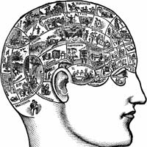
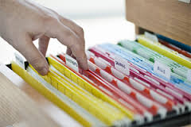
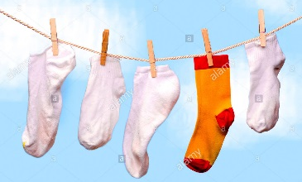
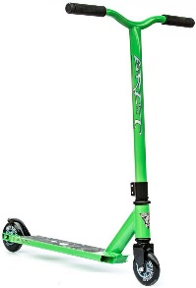

REMEMBERING
Your brain loves to organise things into groups and categories.
Your brain loves stories – you can remember things by connecting them to a narrative.
Your brain looks for differences – if it looks out of place or is an odd combination, they are more memorable.

Slide 4

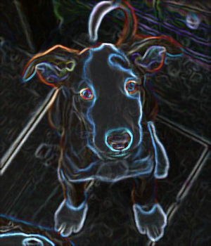
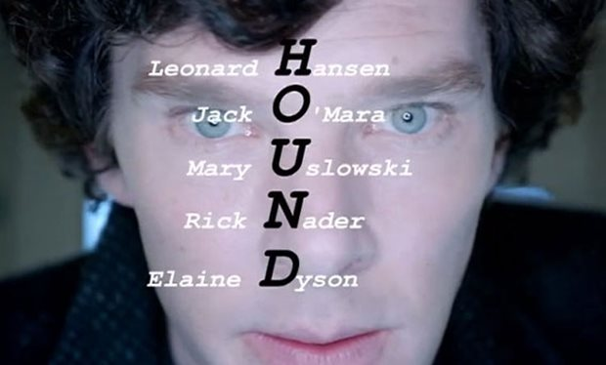
REMEMBERING
Mnemonics
Pictures alongside words also help you to remember
ROYGBIV

Slide 5
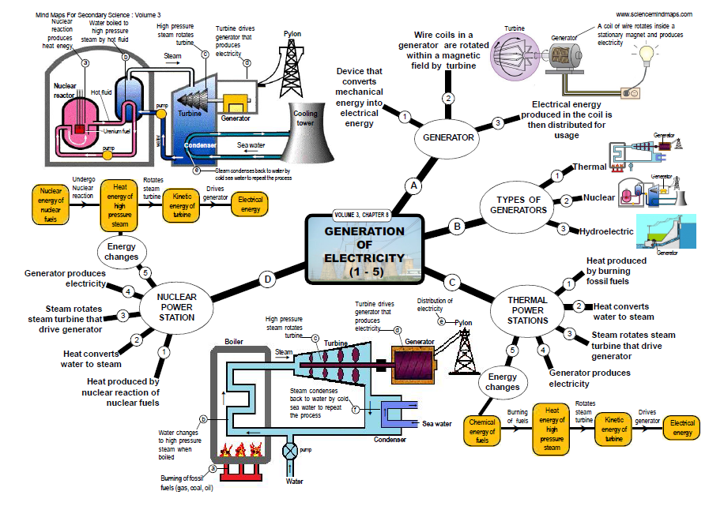
REMEMBERING
Mind Maps
TOPIC – Use Image
Branches – thick lines
MAIN POINTS – CAPITALS
Branches - thin lines
Sub-points - lower case
Remember connections between ideas.
Start with the topic in the middle and branch out.

Slide 6
REMEMBERING
Mind Maps

Slide 7
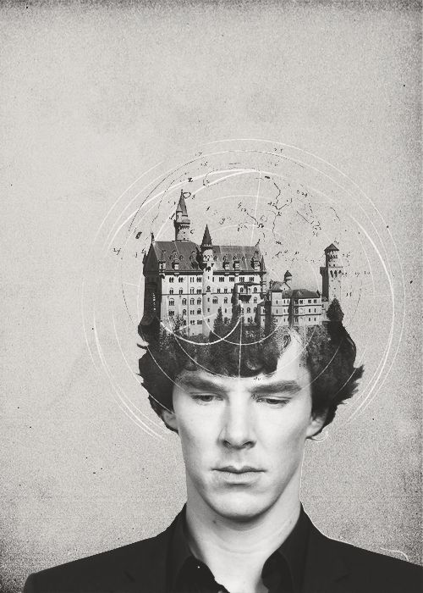
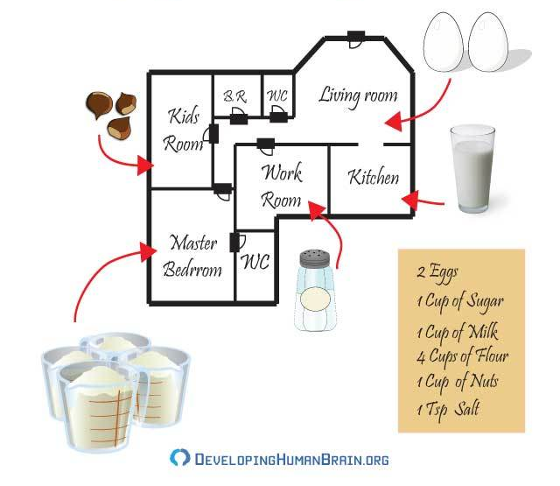
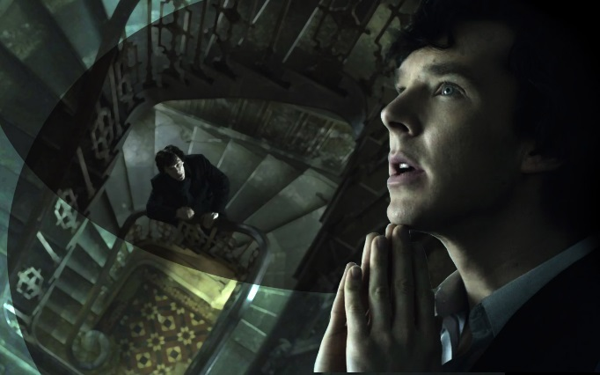
REMEMBERING
Memory Palaces
Imagine a trip through your front door into the living room followed by your kitchen and so on.
Stick your items (mentally) to objects you might see.
Experts create memory palaces made of imaginary rooms and mentally walk around them to retrieve vast amounts of information – like Sherlock

Slide 8
Session 2
The aim of this session is to:
Learn to REMEMBER
Learn to REVISE

Slide 9
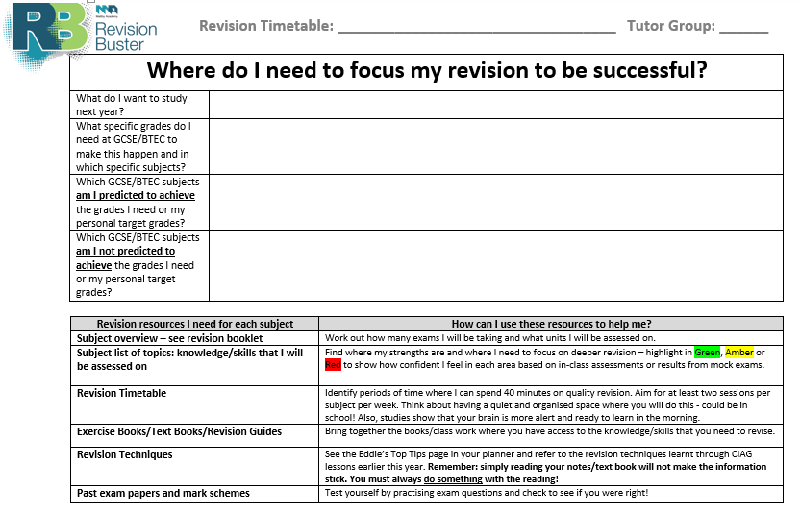
REVISE
Planning is key!
Checklist of topics to cover
Organise resources to revise from: Notes/Text books/Exam Questions/Mark Schemes
Timetable for revision

Slide 10
REVISE
Condense your notes
1. Organise – Get all your notes together and organised into subjects and topics
2. Summarise – write a summary of the main points from each topic onto one sheet of A4
3. Condense – now condense each summary down to the main ideas, key terms and key points – write these on index cards or A4 cut into 6

Slide 11
REVISE
Flashcards
Research shows that this is one of the most effective strategies for revision
Flashcard: Write something you need to know on one side
Flashcard:
Write the answer on the other side
History: Nazis 1933-39
The ways Nazis used propaganda to control attitudes 1933-39
History: Nazis 1933-99
Controlled media – Radio broadcasts
Films and Posters – Spread propaganda messages
Rallies – huge spectacle of support
Olympics – 1936 for international propaganda
Register – All artist registered with MPEP

Slide 12
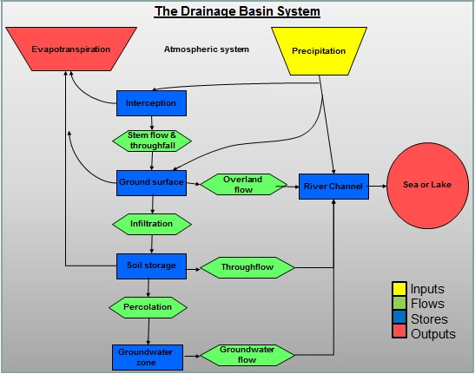
REVISE
Flow Diagrams
Works well for revising processes and sequences:
Science - steps in an experiment or theory concepts
Sequences of events – History, English Literature
Geography - Systems
Extended Responses – WEDRAW / WEATHER / PEEE

Slide 13
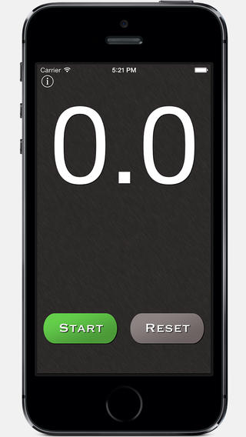
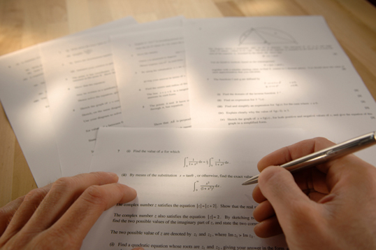
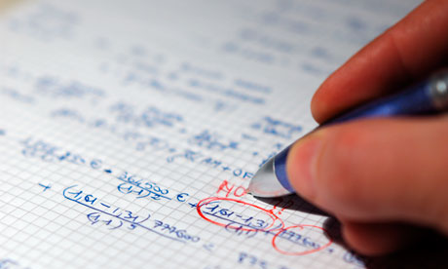
REVISE
Past Papers
Works best for applying/practising skills:
Apply learning by practising exam questions
Timed conditioned
Do every questions
Don’t stop to look anything up
When finished check answers with mark schemes
Use results to diagnose areas where you need more revision
Go back to notes/text book to improve each answer

